Slide 1
Vector Solid Textures
Lvdi Wang
Tsinghua University
Microsoft Research Asia
Kun Zhou
Zhejiang University
Yizhou Yu
University of Illinois at Urbana-Champaign
Baining Guo
Tsinghua University
Microsoft Research Asia

Slide 2
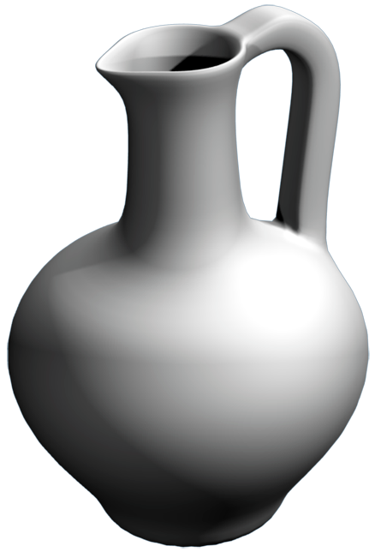
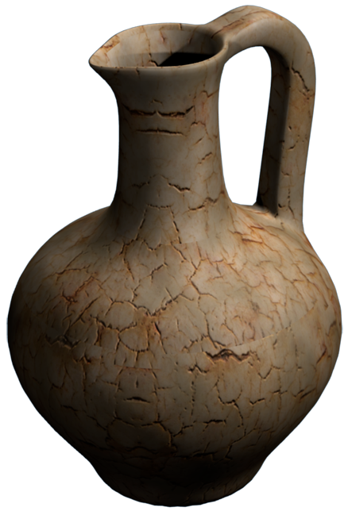
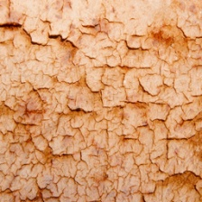
Bitmap Textures
Efficient random access in rendering
A choice between resolution and memory
Texture mapping
Without texture
With bitmap texture

Slide 3
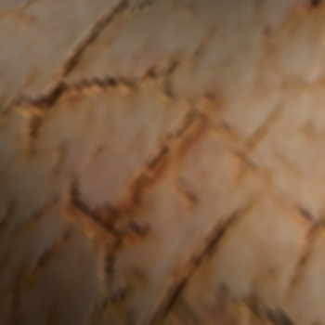
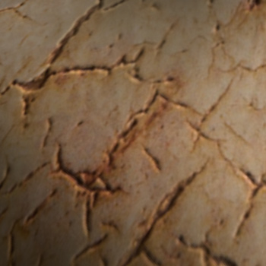
Bitmap Textures
Efficient random access in rendering
A choice between resolution and memory
Resolution: 256²
Memory: 0.2 MB
Resolution: 1024²
Memory: 3.0 MB

Slide 4
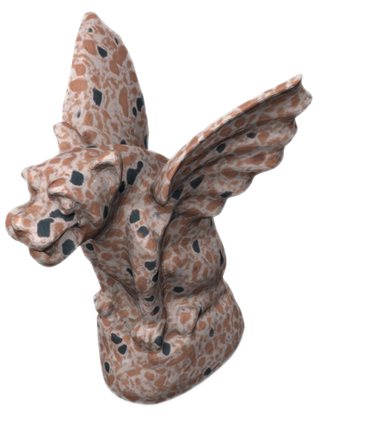
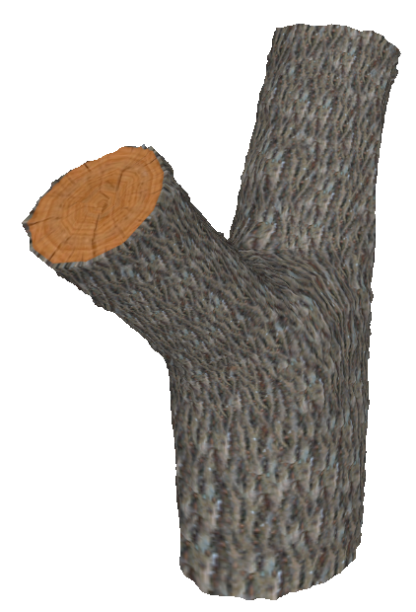
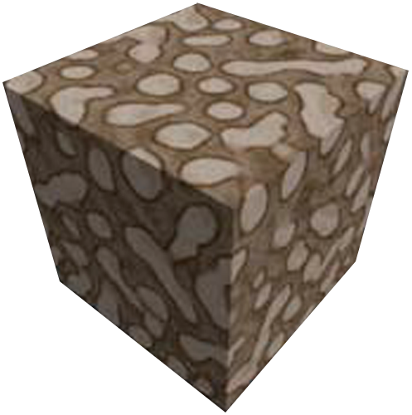
Bitmap Solid Textures
No need for parameterization
Consistent interior & exterior
Memory consumption increases cubically!
[Kopf et al. 07]
[Dong et al. 08]
[Takayama et al. 08]

Slide 5
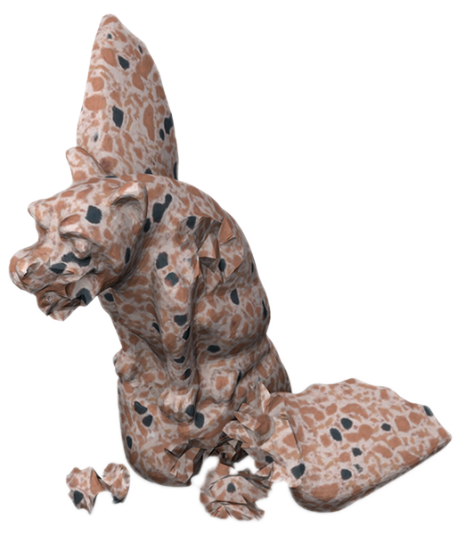
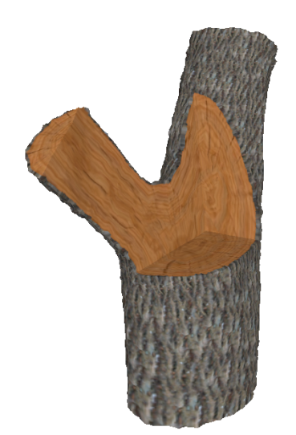
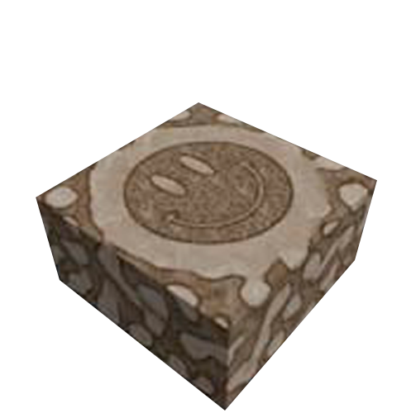
Bitmap Solid Textures
No need for parameterization
Consistent interior & exterior
Memory consumption increases cubically!
[Kopf et al. 07]
[Dong et al. 08]
[Takayama et al. 08]

Slide 6
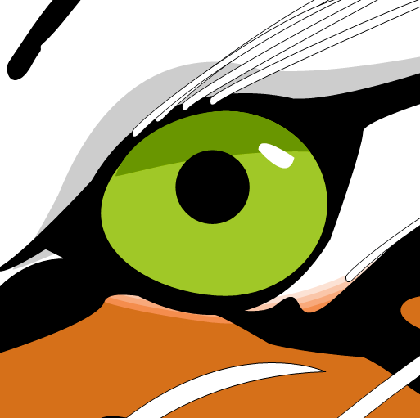
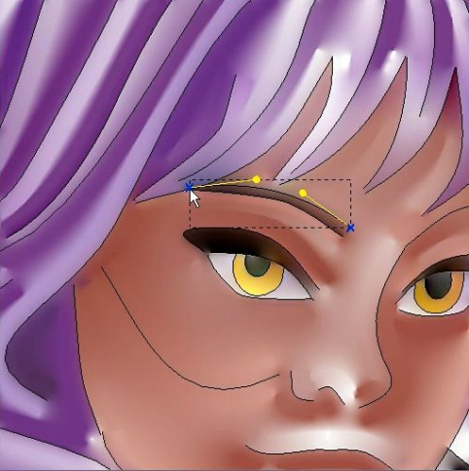
Vector Graphics
Compact and resolution-independent
Limited to 2D content
SVG (www.croczilla.com)
Diffusion Curves [Orzan et al. 08]

Slide 7
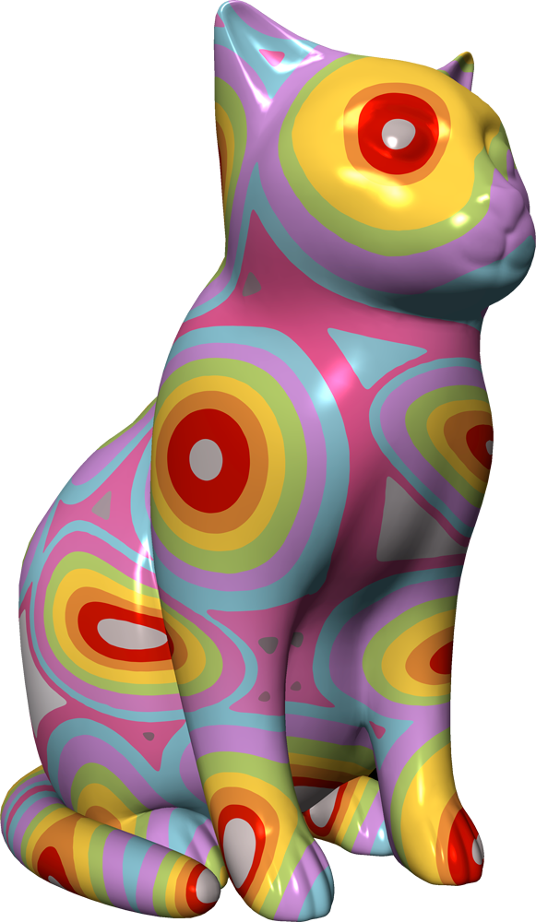
Vector Solid Textures
Resolution-independent
Efficient rendering
Compact storage
Benefits of solid textures
A VST textured model
Rendered at 110 Fps
Size: 1.55 MB

Slide 8
Overview
Vector Solid Textures

Slide 9
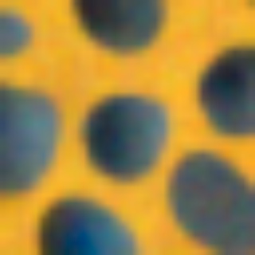
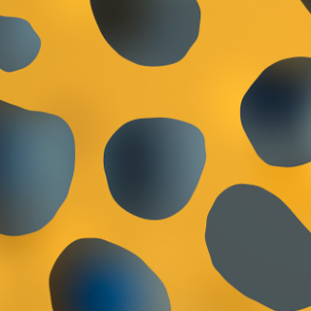
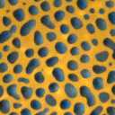
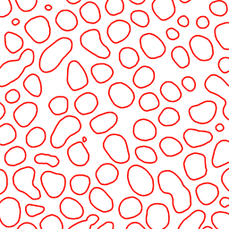
Texture Decomposition
Sharp discontinuities + Smooth variations
2D texture
Bitmap texture
(linear interpolation)
Vector texture
Notes:
We have observed that most natural textures can be decomposed into sharp color discontinuities and smooth color variations.
The key point of resolution-independency is to maintain the sharpness at color discontinuities during magnification.

Slide 10
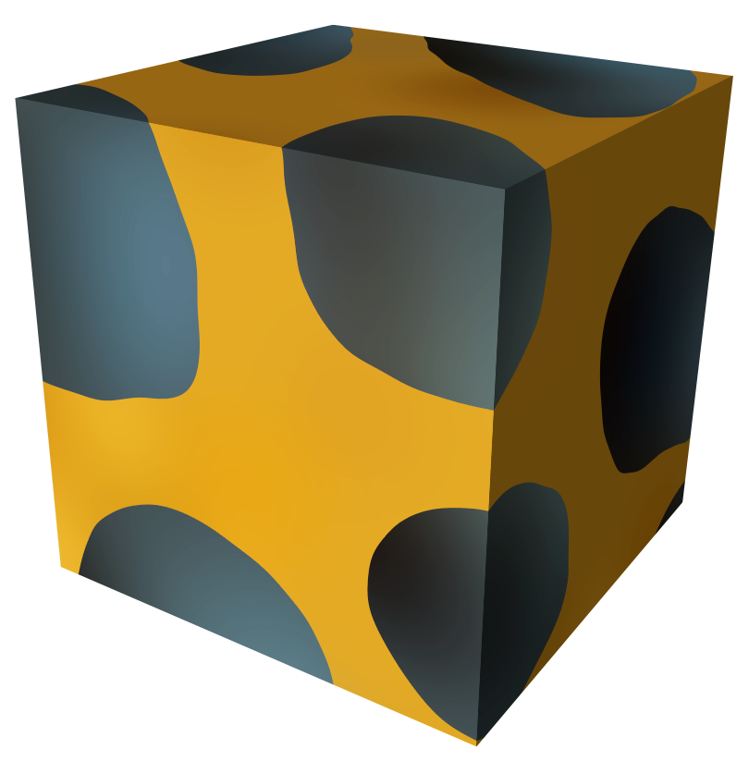
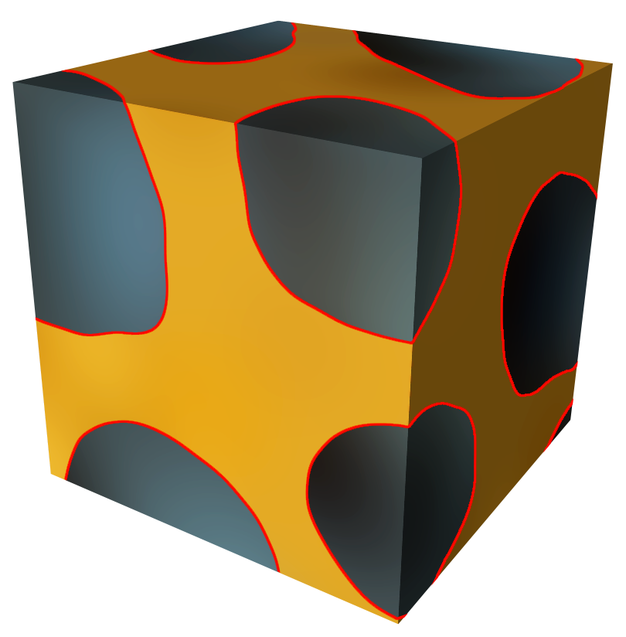
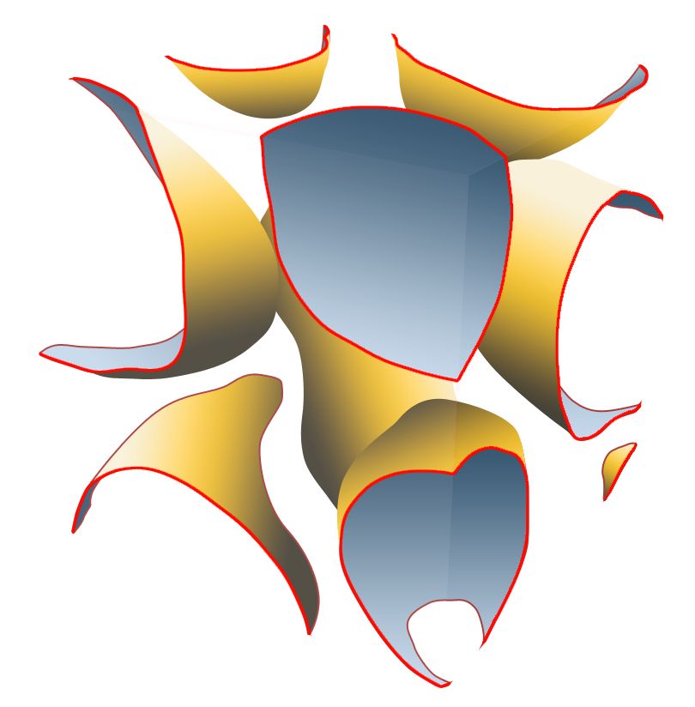
Texture Decomposition
Sharp discontinuities + Smooth variations
Solid texture
Discontinuities highlighted
Surfaces formed by discontinuities
Notes:
In 2D vector graphics, such color discontinuities are typically represented by curves, while in a solid texture, they form 3D surfaces and divide the entire texture volume into separate regions.
Within each region we assume the color variations are relatively smooth and thus insensitive to magnification.
Such decomposition allows us to treat these two types of features differently.

Slide 11
Key Components
Region boundaries
Region labels
Color variations

Slide 12
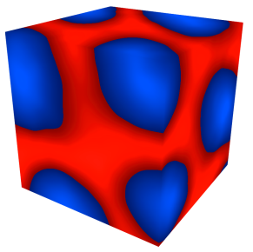
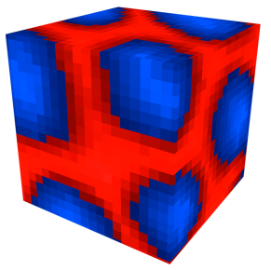
Key Components
Region boundaries
Region labels
Color variations
Signed distance function
Stored on a 3D grid
Tricubic interpolation
+1.0
0.0
-1.0
3D surfaces
Signed distance function
Notes:
The region boundaries correspond to the sharp color discontinuities in the texture.
They are 3D surfaces that divide the texture volume into separate regions.
We define these surfaces implicitly through a 3D signed distance function.
Given some 3D surfaces in a volume, we can define a 3D real-valued function where the absolute value at any location is the shortest distance to the nearest surface point, and the sign indicates whether a location is inside or outside a surface.
Here is an example distance function where the signed distance is visualized in pseudo color.
We say it defines the surfaces implicitly because the set of all locations where the function value is zero are exactly the original surfaces, although we don’t even know the parametric expression of the surfaces.
We store the distance function by recording its values at the voxels of a 3D grid.
The value at an arbitrary location can be reconstructed on-the-fly by tricubic interpolation from nearby voxels in the grid.

Slide 13
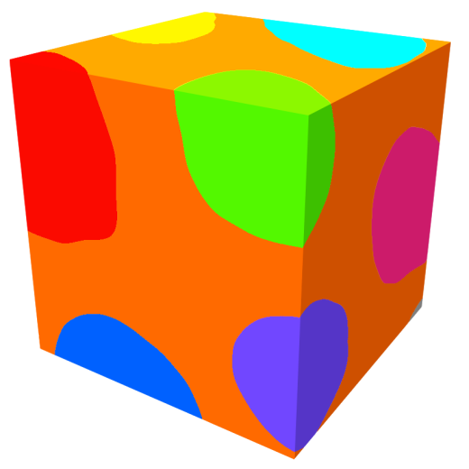
Key Components
Region boundaries
Region labels
Color variations
Conceptually: Stored on the SDF grid
In practice: Efficient compression
Region labels
Notes:
Since the region boundaries divide the texture volume into separate regions, we assign a unique label for each region, as shown here in pseudo-color.
In order to efficiently determine which region an arbitrary location belongs to, we conceptually store the region labels at every voxel of the signed distance function grid.
However, unlike the distance function, labels are constant within each region, so in practice we can use an efficient method to minimize the required storage.

Slide 14
Key Components
Region boundaries
Region labels
Color variations
Radial Basis Functions (RBF)
RBFs illustrated in 2D
Notes:
Within each individual region, we assume the color variation is relatively smooth and can be modeled by a set of radial basis functions.
Here we use a 2D illustration for clarity.
The radial basis functions can be imagined as individual radial color gradients scattered inside the texture volume.
Each of them has a finite radius and affects the color within its range.
Thus the color at an arbitrary location can be computed by adding up the impact of nearby RBFs.
Compared to the limited types of color gradients in common 2D vector representations, these radial basis functions provide a similar, but more flexible and generic method to model complex color variations.

Slide 15
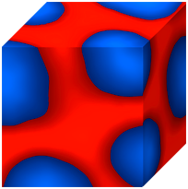
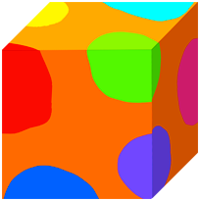
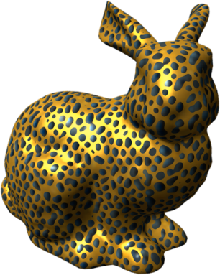
Real-Time Rendering
Basic rasterization pipeline:
Tex. volume
SDF
Labels
RBFs
p
t
D(t)
L(t)
Final color
Notes:
During real-time texture mapping, the vector solid texture is rasterized to the screen.
To find the color of a pixel, we first get its 3D texture coordinates T.
By looking up the corresponding signed distance value and region label at coordinates T, we can determine which region it belongs to.
Finally, the impact from all the radial basis functions in that region is added up to yield the final color of the pixel.

Slide 16
Vectorization
Bitmap Solid Texture

Slide 17
Vectorization
Create SDF
Label Regions
RBF Fitting

Slide 18
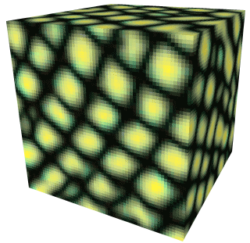
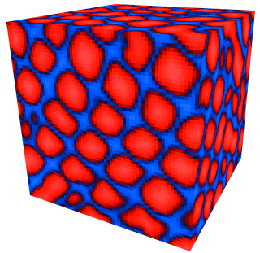
Vectorization
Create SDF
Label Regions
RBF Fitting
Does there already exist one?
Texture synthesis algorithms use them as Feature Maps [Lefebvre & Hoppe 06] [Kopf et al. 07] …
color
mask
SDF
color
SDF
Input 2D exemplar
Output solid texture
Notes:
The first thing to do is to identify the sharp features in the original bitmap solid texture by creating a signed distance function.
But before doing that, we may find that some bitmap solid textures already come up with a distance function.
Many example-based texture synthesis algorithms use signed distance functions as an additional “feature map” channel to improve the structure coherence during the synthesis.
Such distance function can be directly used for vectorization because in most cases it exactly indicates the sharp color discontinuities in the original texture.

Slide 19
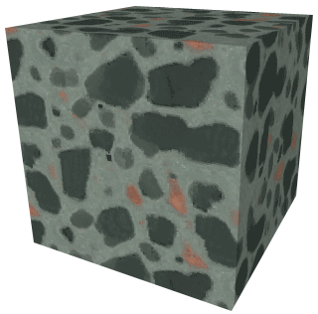
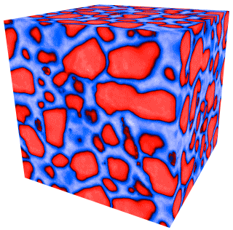
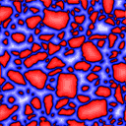
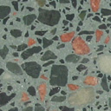
Vectorization
Create SDF
Label Regions
RBF Fitting
We can also create one
Image Analogy [Hertzmann et al. 01]
:
: :
:
2D slice
2D mask
2D SDF
Solid texture
3D SDF
Notes:
If the bitmap solid texture doesn’t contain a distance function, we let the user to create one manually.
In this case the user only needs to choose a single 2D slice from the solid texture, and create a 2D binary mask for the slice.
From this mask a 2D signed distance function can be easily computed, then an algorithm similar to Image Analogy will automatically synthesize the 3D distance function for the user.

Slide 20
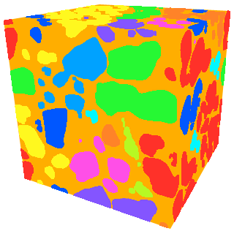
Vectorization
Create SDF
Label Regions
RBF Fitting
Find connected components in the signed distance function
Signed distance function
Region labels
Notes:
Once we have the distance function, we could assign a unique label to each region separated by the zero-isosurface of the distance function. A simple flood-fill method would serve this purpose..

Slide 21
Vectorization
Create SDF
Label Regions
RBF Fitting
Find n RBFs that best approximate the existing color distribution
Techniques:
L-BFGS-B minimizer [Zhu et al. 97]
Teleportation [Cohen-Steiner et al. 04]
Notes:
The final step is RBF color fitting, which is to find a given number of radial basis functions that best approximate the existing color variation within every region.
Due to the large number of RBFs in a texture, this is a highly non-linear optimization problem.
We use the L-BFGS-B algorithm and utilize teleportation to avoid entrapment in local minima.

Slide 22
Results & Applications
Vector Solid Textures

Slide 23
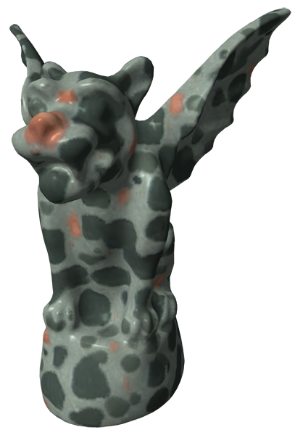
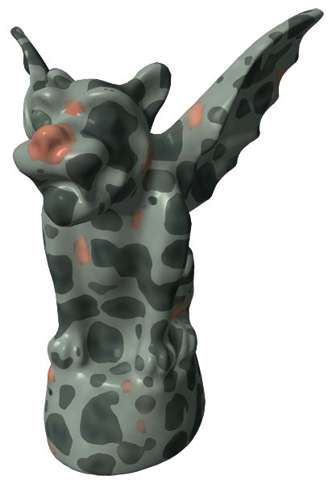
Bitmap solid texture
Resolution: 128³
Memory: 6.0 MB
Vector solid texture
Num. RBFs: 5183
Memory: 1.2 MB

Slide 24
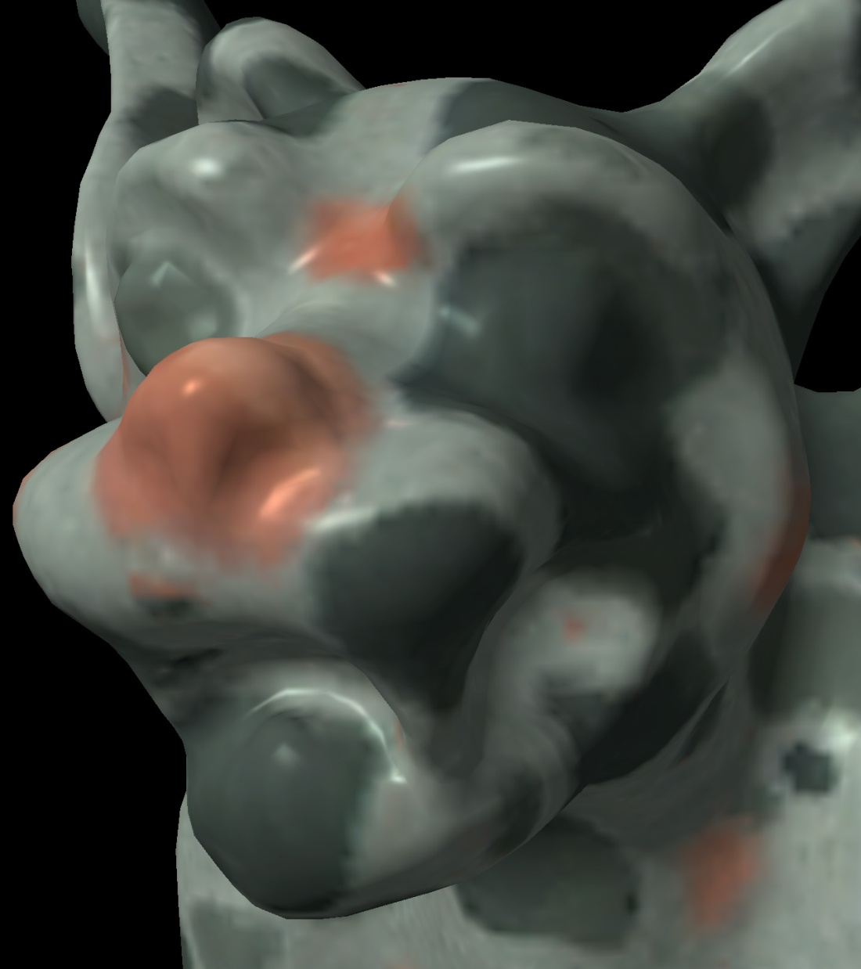
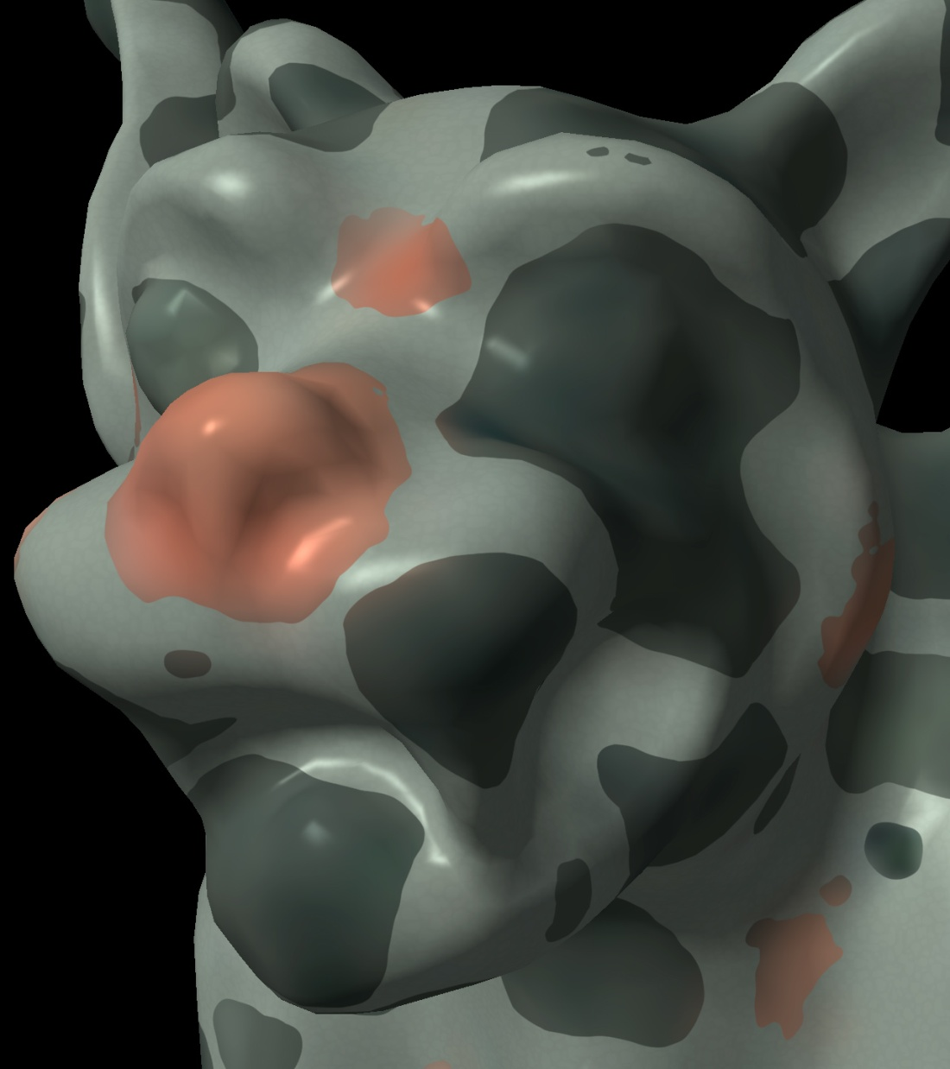
Bitmap solid texture
Resolution: 128³
Storage: 6.0 MB
Vector solid texture
Num. RBFs: 5183
Storage: 1.2 MB

Slide 26
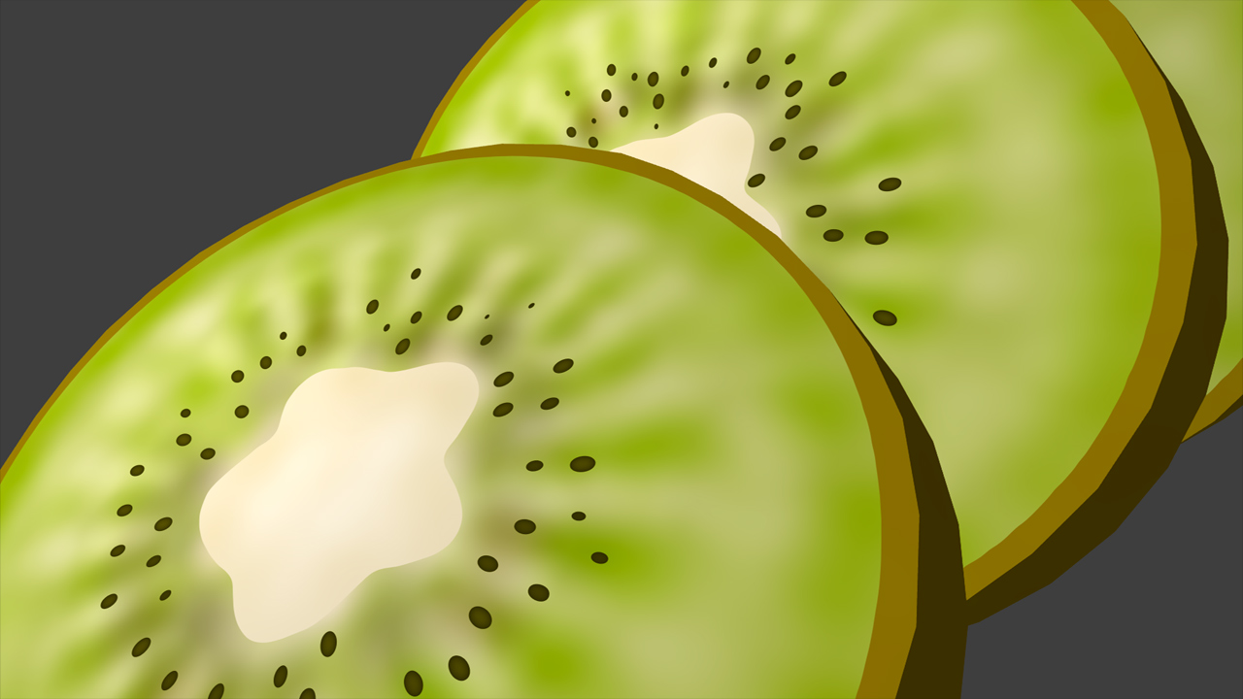
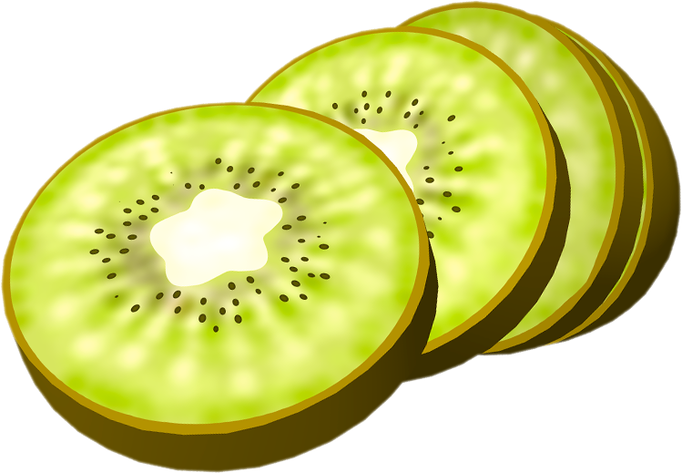
Num. RBFs: 7137
Storage: 1.3 MB

Slide 27
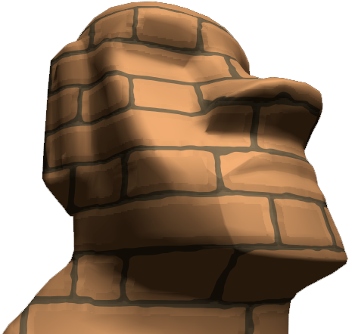
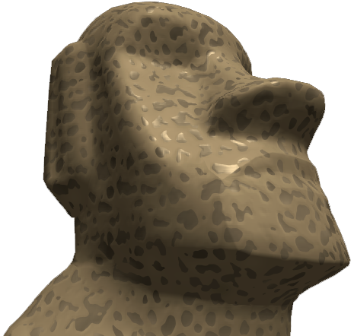
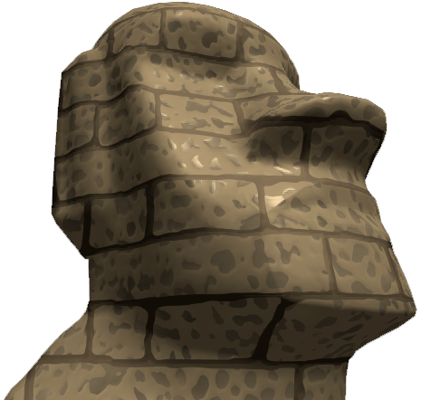
Texture Composition
Algebraic and Boolean operations on textures
+
=
VST #1
VST #2
Hybrid VST

Slide 28
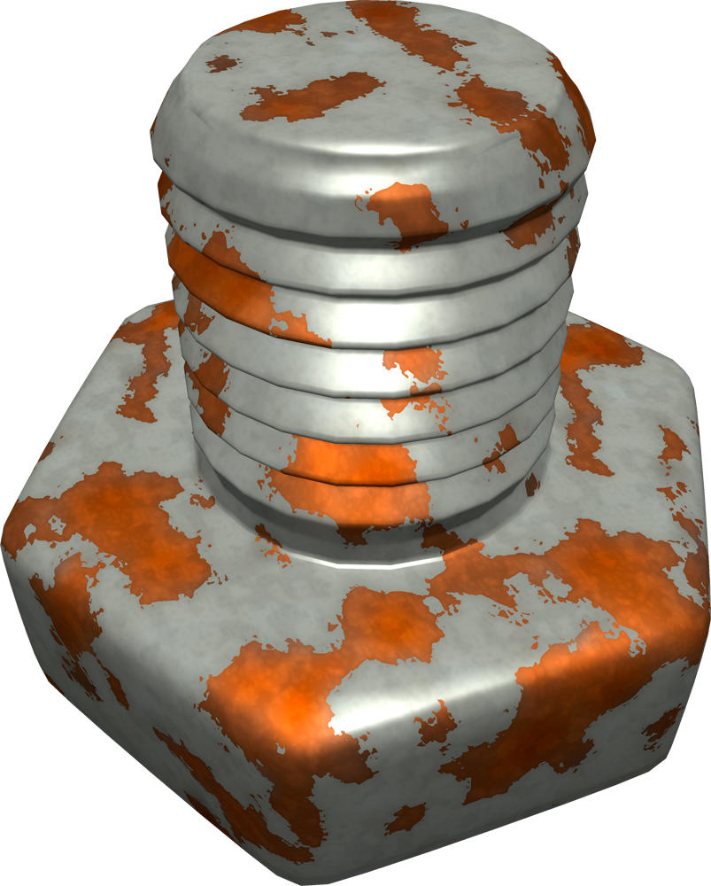
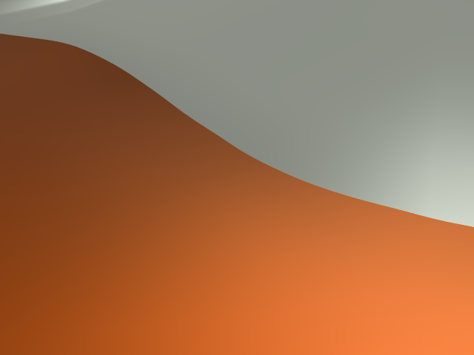
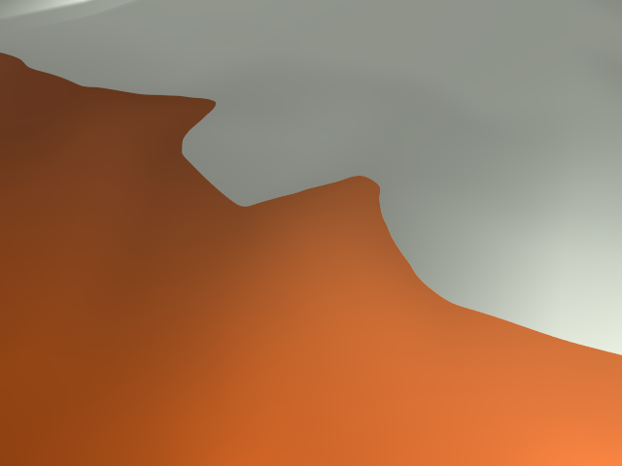
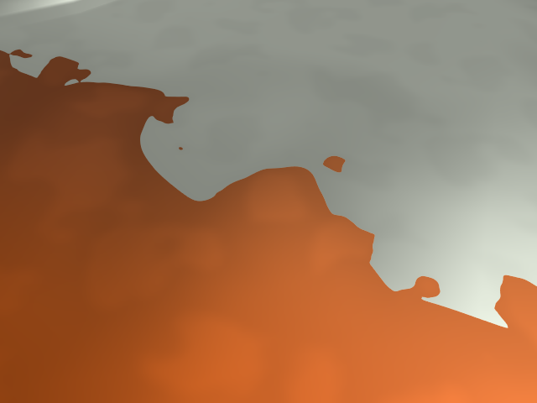
Texture Composition
Self-similar textures
1 scale
2 scales
3 scales

Slide 29
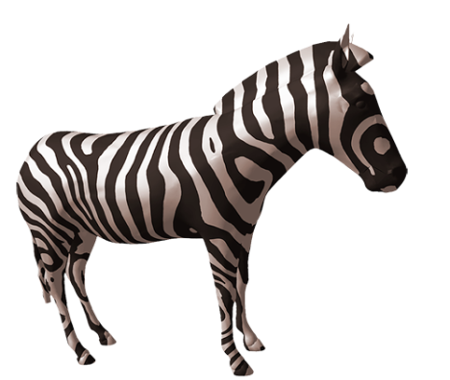
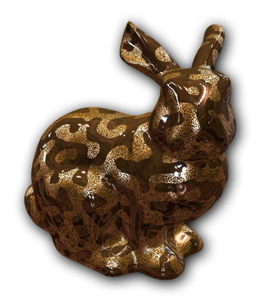
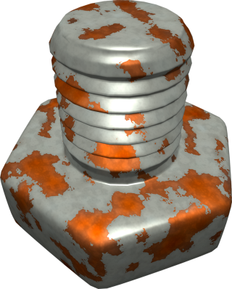
Statistics
Performance: 90-700 Fps NVidia GeForce 8800GTX, 800² window
Storage: 17-26% of the respective input bitmap solid texture

Slide 30
Discussion

Slide 31
Region Label Pairs
Store two region labels at every voxel
Octree compression [Lefebvre et al. 05]
Save 70% - 99.998% storage
Useful in rendering
Notes:
Remember that we have conceptually stored the region label at every voxel of the distance function grid.
In practice, we actually store a pair of region labels at every voxel.
One for the region that contains the voxel and a second one for the region doesn't contain the voxel but closest to it.
Counter-intuitively, storing the label pairs needs much less memory than storing labels only, because we can use octrees for efficient compression.

Slide 32
Anti-aliasing
Utilize SDF and region label pairs
δ
Without anti-aliasing
With anti-aliasing
High quality anti-aliasing
Little performance overhead
Notes:
When rasterizing any vector graphics, anti-aliasing must be considered if we want high quality results.
Let’s say we want to rasterize a boundary between two regions to a 4-by-4 pixel window on the screen.
If we directly evaluate the region label for each pixel, we would get aliased boundary due to the abrupt changing of region belongingness.
The ideal solution would be to consider each pixel as a square and compute the color according to the coverage of each region in the square.
We use an approach that fully utilizes the signed distance function and region label pairs.
Because the distance function already encodes how far the pixel center is from the nearest boundary, and the label pairs tell us which the two relevant regions are, what we need is to define a distance threshold, DELTA.
The color of any pixels closer to the boundary than DELTA is computed as a linear interpolation between the colors from the two regions.
When DELTA is chosen properly, this approach approximates the region coverage more accurately and achieves much higher quality than the widely used super-sampling methods with a relatively low number of samples.
Moreover, because it only needs to evaluate one extra color, the performance overhead of anti-aliasing is almost negligible.

Slide 33
Boundary Softness
Some boundaries are not that sharp
Same as anti-aliasing, but with different δ
Notes:
In some 2D vector representations, such as Diffusion Curves, the user can control the blur amount of the edges.
This is useful because even in a vector representation, some edges, or boundaries, are not necessarily always that sharp.
We also allow the user to control the softness of region boundaries in a vector solid texture.
The idea is essentially same as in anti-aliasing, the only difference is that we consider the distance threshold DELTA in this context as an intrinsic attribute of region boundaries and allow the user to change it on-the-fly.

Slide 34
Boundary Softness

Slide 35
Explicit vs. Implicit
Explicit surface
Implicit surface
Random-access
Vectorization
Compactness
Flexibility
Root finding
Direct & utilizes GPU
Surface fitting
Robust and efficient
Adaptive
Compression
Less constraint
2-colorable constraint
Multiple SDFs
Notes:
Unlike most 2D vector representations, we chose to define the region boundary surfaces implicitly.
While making this choice, we’ve considered some different aspects.
In our implicit representation, the nature of signed distance function requires that the regions in a texture must be identifiable by a single binary mask, or in terms of graph theory, the regions should be two-colorable.
This constraint seems to hold for a wide range of solid textures we have observed, but there are still exceptions.
A possible solution is to use multiple signed distance functions to identify different regions, as we have shown in the texture composition application. Nevertheless, this is a limitation of our method.

Slide 36
Conclusion
Contribution: A compact random-access vector representation for solid textures
Future work: Interactive texture authoring tool

Slide 37
Thank You!

